Slide 1
Increasing Inquiry-Based Questions in Middle School Mathematics Classrooms
Expanding Middle School Students’ Understanding of Algebraic Reasoning for Students With Disabilities
American Institutes for Research
Notes:
The purpose of this module is to focus on the importance of asking higher level, inquiry-based questions that lead to increased student discussion, student talking, and overall discourse in middle school mathematics classes. Student discourse leads to greater student engagement and conceptual understanding but is often limited in middle school mathematics classrooms. Additionally, many students who struggle or students with disabilities often lack the prerequisite skills, vocabulary, and working memory to actively engage. The limited engagement can further widen the academic gap. This module is designed to be completed during a full-day professional development, or it may be broken into smaller chunks. The mathematics problems are designed to be completed with partners or in small groups and then discussed with the larger group.
The handout includes background information, graphs to analyze, vocabulary tables, and student case studies.
Instructions for using the speaker notes
• Text formatted in standard font is intended to be read aloud or paraphrased by the facilitator.
• Text formatted in italics is intended as directions or notes for the facilitator; italicized text is not meant to be read aloud.
Welcome participants to the training. Introduce yourself (or yourselves) as the facilitator(s) and briefly cite your professional experience in regard to mathematics instruction and supporting students who struggle and students with disabilities in mathematics.
Although permission to reprint this publication is not necessary, the citation should be as follows: American Institutes for Research. (2022). Increasing inquiry-based questions in middle school mathematics classrooms: Expanding middle school students’ understanding of algebraic reasoning for students with disabilities. Office of Special Education Programs, U.S. Department of Education.

Slide 2
Objectives
Participants will
understand national trends in mathematics,
identify common characteristics of students who struggle,
define and increase mathematics discourse,
identify different types of questions that lead to increased student discussion, and
consider instructional planning and identification of appropriate tasks.
Notes:
[Read slide.] This is a suggested agenda and can be altered to fit your needs.

Slide 3
National Trends in Mathematics
Notes:
[Read slide.]

Slide 4
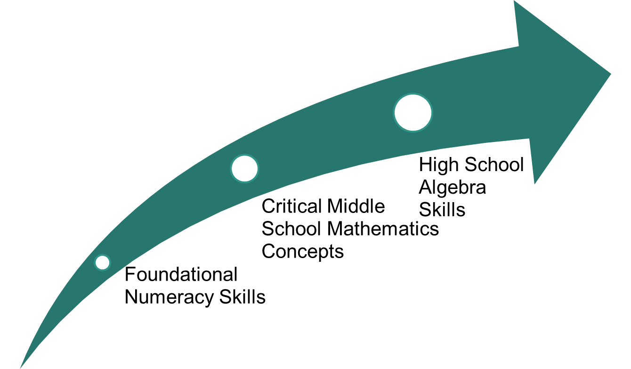
Developing Foundations of Algebra
Notes:
Mathematics is an area in which the skills are highly interconnected, and, when students do not fully develop the foundational skills in elementary school, their learning becomes filled with misconceptions, or they lack conceptual understanding. As math becomes more challenging, the holes and misconceptions in student understanding affect concept development in middle school, which can hinder student understanding of algebraic concepts in high school. This situation becomes a problem because algebra is considered the gateway to other math classes and is often the prerequisite for many postsecondary classes.

Slide 5
Interconnectedness of Mathematics
Mathematical standards are not stand-alone skills.
They build upon standards within the same grade level.
They build upon standards across grade levels.
As students get older, the gaps within and across grade levels increase, leading to
less conceptual understanding,
development of misconceptions, and
greater need for intervention support.
Notes:
As indicated on the previous slide, many students with mathematics difficulties develop gaps in learning and misconceptions that hinder conceptual understanding. We often see greater gaps skills in middle school when standards tend to be more difficult and are connected to previous standards and students show an inability to generalize previous skills to more demanding tasks.

Slide 6
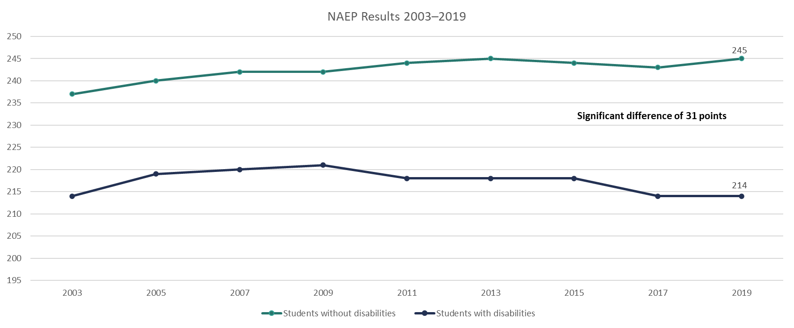
National Mathematics Trends: National Assessment of Educational Progress (NAEP) Grade 4
Notes:
As you can see, between 2003 and 2019, a significant gap exists between scores of fourth-grade students with and without disabilities on the NAEP. This is a gap that has not decreased over time and, in fact, has increased. These results are for Grade 4, but how might these skill gaps in skills impact students in middle school?

Slide 7
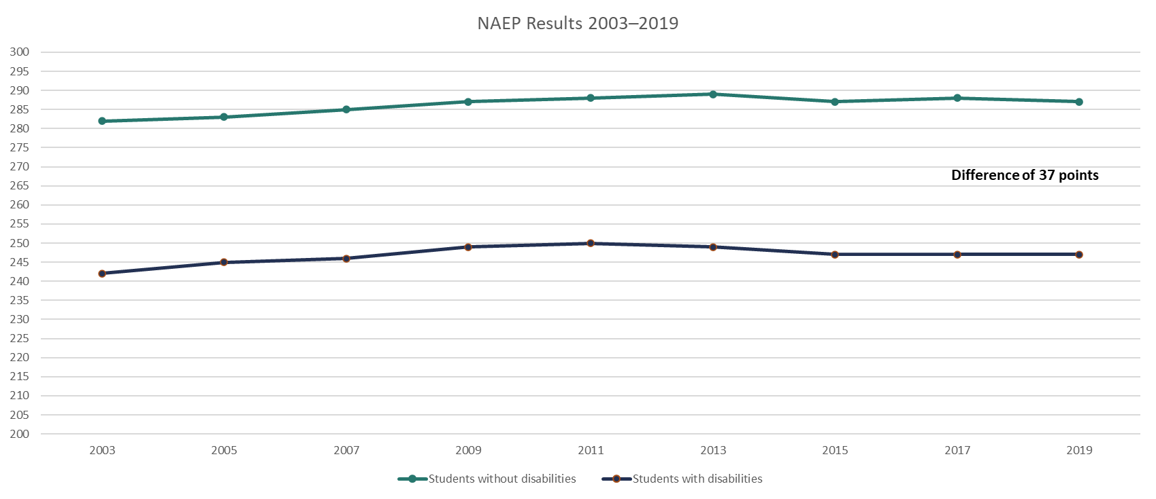
National Math Trends: NAEP Grade 8
Notes:
From Grade 4 to Grade 8, we do not see much difference, meaning the gap between students with disabilities and students without disabilities is not closing.

Slide 8
Characteristics of Students With Mathematics Difficulties
Notes:
[Read slide.]

Slide 9
Let’s Chat!
Why do students struggle in mathematics?
What specific skills do you see as the most challenging?
What misconceptions do you see students demonstrating in class?
Why is this happening?
Think about your students’ mathematics experiences.
To what extent did the students receive the same math experience?
How can this impact your teaching?
Notes:
[Read slide. Give participants a few minutes to think about and write down responses. Have participants discuss in small groups. If professional development is virtual, utilize Jamboard (or some other kind of online shared board) with different color sticky notes and have participants write responses.]

Slide 10
Mathematics Warm-Up
Complete the following problem: ​
Kara is buying party invitations. The party store sells a $10 box that contains 24 cards or a $25 box that contains 60 cards. Which is the better deal? Why?​
Create another card box that would be equivalent to the better deal.​
Now that you have solved, show a different way to solve. ​
(SanGiovanni & Novak, 2018, Task 20a)
Notes:
[Read slide. Have participants complete the problem on chart paper or Jamboard and then share how they solved. Ask participants how they solved was different or similar to others.]

Slide 11
Anticipating
What was the task?
Put into your own words the problem you were asked to complete.
What skill(s) are needed?
Anticipate student responses.
How would your students have solved?
What makes this problem challenging for students with mathematical difficulties?

Slide 12
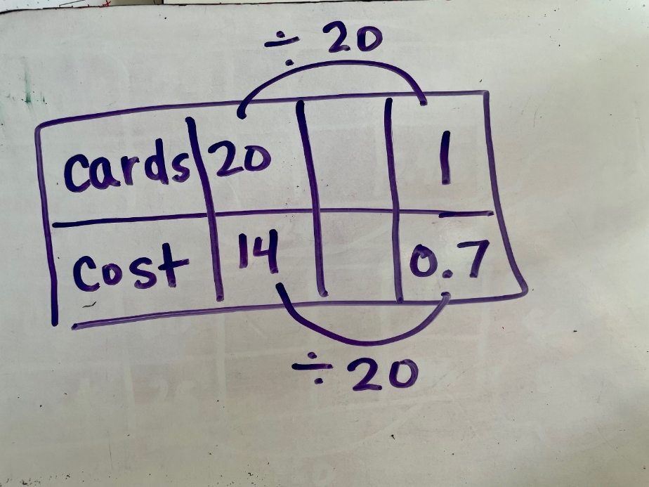
Analyze This Student’s Mathematics Thinking
Does the student understand how to use rates to compare? How do you know?
How did the student solve?
Are there any errors?
Is any additional instruction or support needed? How do you know?
Notes:
[First, ask participants to respond to the first part of the question. In this example, the student shows that they have an understanding of how to find unit rates. Then click to the next slide to see the next part of the question. The next part of the question shows that the student lacks the understanding of why or conceptual understanding of unit rates. The student understands the process but cannot apply it.]
How can we describe the student’s understanding of how to solve? How can we describe the student’s understanding of why or how to use unit rates?

Slide 13
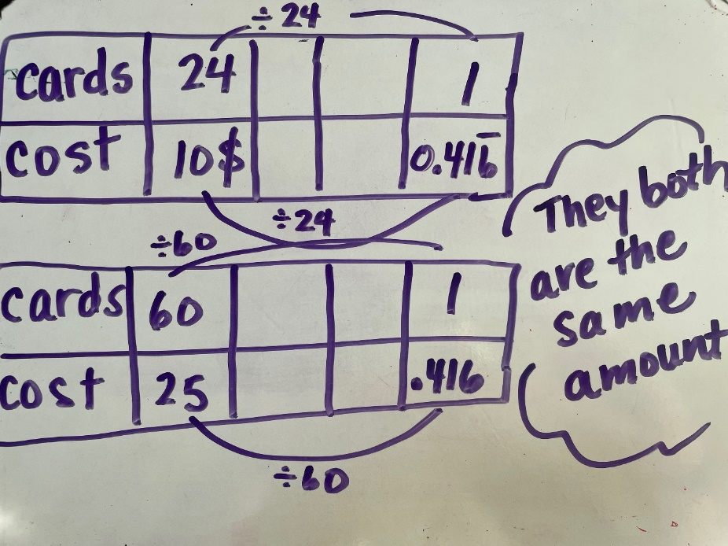
Analyze This Student’s Mathematics Thinking (continued)
Does the student understand how to use rates to compare? How do you know?
How did the student solve?
Are there any errors?
Is any additional instruction or support needed? How do you know?
Notes:
Does the student have the same understanding of unit rates as you first assumed? Why? How can we describe the student’s understanding of how to solve? How can we describe the student’s understanding of why or how to use unit rates? If we simply ask students to complete the procedure, we do not know if they truly understand the concept. By asking an application question, we see that the student just simply divides by the amount, without truly understanding why we are doing this process.

Slide 14
Common Skill Deficits in Students With Mathematics Difficulties
Working memory​
Number sense​
Symbols​
Whole-number computation​
Word problem solving​
Vocabulary ​
Self-regulation
Notes:
These are the common skill deficits in students with mathematic difficulties. We will go into more detail about each of these deficits on the next slides.

Slide 15
Working Memory
“. . . a limited capacity central executive system that interacts with a set of two passive store systems used for temporary storage of different classes of information.”(Baddeley & Logie, 1999, p. 34)​
Implications for mathematical operations include the following:​
Number computations​
Effective strategy use​
Word problems​
Multistep problems
Retrieval or fluency
Notes:
Working memory affects number computations, specifically strategy use. Often, students will use inefficient strategies, such as counting all, and do not remember or use the strategies correctly. When the student takes so much time and “clogs” the working memory, problem solving, and multistep problems can provide greater challenges. Working memory affects word problem solving and multistep problem solving because the student must store so much information and can tire easily, thus forgetting to do additional steps or check the reasonableness of their answers.
Think of reading and fluency. When a student takes a long time to read, they get tired, and comprehension lowers. This is also true of math and working memory.

Slide 16
Number Sense
Flexibility with numbers​; ability to make sense of what numbers mean and the ability to manipulate or “see” patterns in numbers
Skills include the following:
Counting
Decomposing
Magnitude comparisons
Links to advanced computational strategies
Precursor to fractions
Notes:
Students with a strong number sense in early elementary school are more successful in later grades. A more developed number sense leads to flexibility of number decomposition (Siegler, 1988) and an understanding of counting principles, such as cardinality, order, and abstraction (Geary, 2004). The mastery of number sense, flexibility in counting, and decomposing is essential for long-term conceptual understanding.

Slide 17
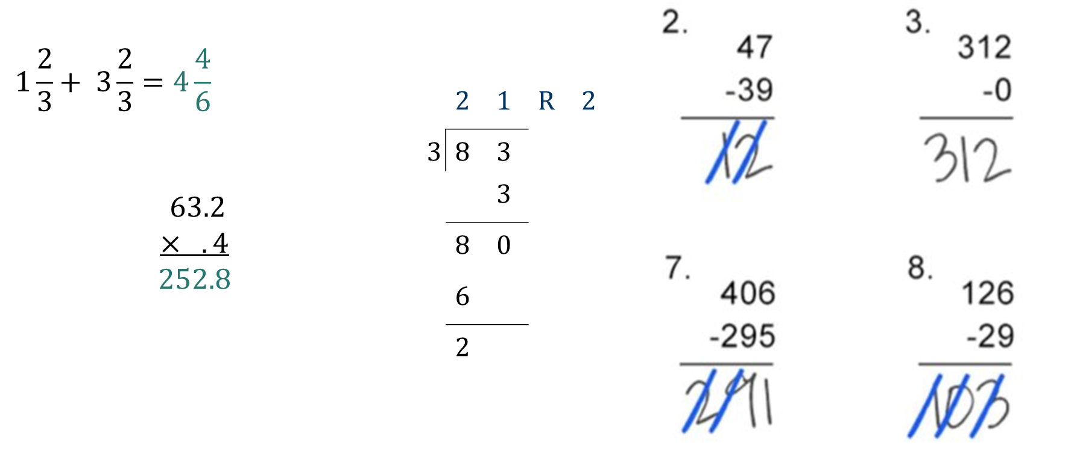
Examples of Number Sense Challenges
Notes:
Take a look at these examples. What do you notice? Although the math is considered basic, or more elementary, it can impact students in middle school. What errors are evident? What misconceptions are evident? For students with mathematics difficulties, number sense challenges become very evident when they are completing basic computations within more demanding tasks, such as finding area or perimeter, unit rates, and so forth. Consider these errors. The student has no concept of reasonability. We often see this play out when a student writes down whatever number is shown on the calculator or select the answer choice that is “way out in left field.” How do you see number sense affecting your students’ abilities to be successful in your class?

Slide 18
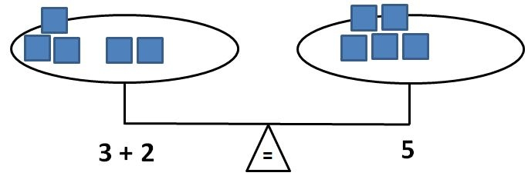
Symbols
At your table, brainstorm all the symbols students see across Grades 6–8.
Symbols are an integral part of mathematical language.
Students need to develop an understanding of the symbolic equivalence between numbers and symbols.
Explicitly teach operational symbols, such as the following:
Equals sign
Addition and subtraction
Multiplication and division
Fraction bars
Notes:
[Set a timer for 3 minutes. Have participants brainstorm all the symbols students see or are introduced to in Grades 6 – 8. Click for animations. Then read slide.]
[Click for animation.] Teachers often move too quickly to symbolic representations and do not directly teach the meaning of mathematical symbols. For example, for many students, the equals sign means “answer” rather than “the same as.” A lack of a full understanding of the equals sign affects number sense and computational understanding. In the future, this lack of understanding can affect understanding of equations and can lead to challenges when students are trying to balance equations.

Slide 19
Whole-Number Computations
An efficient and accurate method for solving operational math problems to mastery
Includes both basic facts (addition, subtraction, multiplication, and division) and the ability to apply these skills to multistep computations
Need explicit instruction in strategies to
understand the relationships between numbers and
Gain conceptual understanding of how to solve efficiently.
Notes:
Whole-number computation is important and a key foundational skill for students exiting elementary school and should be part of instruction starting as early as kindergarten. For students receiving intervention support, whole-number computation can be challenging and may be impacted by working memory, as well as by a student’s understanding of how numbers are related to one another, such as the concept of part-part-whole within fact families, how numbers are related, or how to use strategies efficiently. Often, students with mathematical difficulties have delays in both process or conceptual understanding, as well as procedural fluency, which may result in inefficient or incorrect strategy use, thus leading to greater confusion.
What does mastery of facts mean? Ideally, by the end of Grade 5, if students were given an addition, subtraction, multiplication, and division sheet with 100 questions, they could correctly solve at least 80% of the problems on all sheets within 1 minute for each sheet.
How does whole-number computational skills affect student understanding in your class?

Slide 20
Word Problem Solving
Mix of numbers and words in which students apply mathematical skills
Challenges in solving word problems include the following:
Vocabulary
Language
Multiple steps
Selecting correct algorithms
Notes:
Word problems are often the way students are tested to measure their understanding of computational skills yet are often challenged as a result of reading skills, mathematical vocabulary, working memory, and basic number sense. The other challenge with word problems is that students are often not taught efficient strategies to solve. For example, many students rely on key words, an instructional practice that leads to an inability to understand the problem and often leads to an incorrect answer. Students need greater instruction and practice in identification of the schema or problem type with ways to solve that are efficient and can be applied to all word problem types.

Slide 21
Consider This Example
Sebastian is making lemonade. His recipe requires 750 grams of sugar to make 20 liters of lemonade. Sebastian wants to make 12 liters of lemonade.
How many grams of sugar does Sebastian need to maintain the same ratio of sugar to lemonade as in his recipe?
(NAEP, 2017-8M9 #10 M357201)
Notes:
This is a problem from the National Assessment of Educational Progress, Grade 8 in 2017. Why might students struggle in solving? (e.g., vocabulary, such as grams, liters, conversion from grams to liters, multi-step). We often take for granted that students will understand all aspects of a problem if we read it to them or provide definitions. But, even if we made sure that students understood grams and liters, they also need to convert and then identify the ratio to ”make the lemonade.”
*See link to NAEP Questions Tool on resources slide.

Slide 22
Vocabulary
Polysemous words can cause confusion, especially as they pertain to meaning in standard English versus mathematics.
Difference, factor, product
Vocabulary terms are often not explicitly taught as part of core instruction.
Interventions do not always stress the use of mathematical precise language by students and/or teachers.
Consider the role of language in the following sentence:
The teacher said the student is mean.
The teacher, said the student, is mean.
Pair of shoes
Pair of socks
Pair of pants
Notes:
[Read slide. Click for animation.]
Think about the word pair. How many shoes do I have if I have a pair? (2) What about a pair of socks? (2) When you have a pair of pants, how many pants do you have? (1)

Slide 23
Vocabulary Within Instruction
Teachers tend to use vocabulary that has multiple meanings in English.
Give your little brother the “bigger half” of the cookie.
“Carry” the one.
“Borrow” the ten.
“Cancel” when simplifying a fraction or rational expression.
Write or create an improper fraction (Is there a proper fraction?)
Think about this example: “Add these numbers up.”
12 6
+ 7
Notes:
Math vocabulary is challenging. Either teachers do not explicitly teach, assume the student already understands the word, or do not practice using precise language, leading to confusion or lack of understanding. Consider these examples. [Read slide. Click for animation after reading last bullet.]

Slide 24
Self-Regulation
Self-regulation is the attitude and abilities required to act as the “primary causal agent in one’s life and to make choices regarding one’s actions free from undue external influence or interference.” (Wehmeyer, 1992, p. 305)
Self-regulation includes the following three components:
Autonomy
Relatedness
Competence
Lack of self-regulation may lead to decreased academic achievement.
Self-regulation should be embedded within interventions and core instruction.
Notes:
Self-regulation is essential for all students but tends to be a weakness for students with mathematics difficulty. To increase self-regulation, we need to empower students to feel more autonomy, a sense of understanding or relatedness to the material—seeing that mathematics is important—and competence or confidence in being successful with difficult work. When teachers support students, they explicitly teach strategies that lead to deeper understanding, and students tend to increase self-regulation and often are more engaged in their own learning!

Slide 25
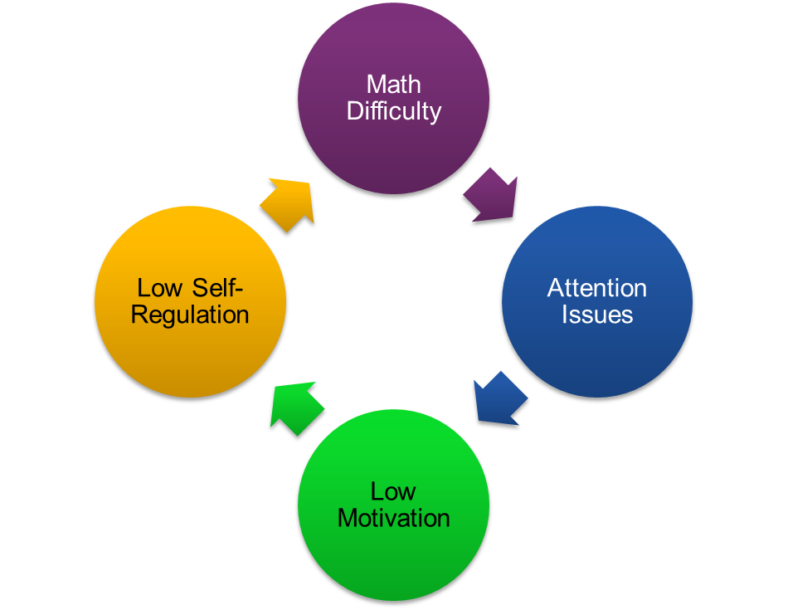
Self-Regulation and Motivation
Notes:
When we think about self-regulation, we often think about it paired with motivation. For students in middle school, they have been stuck in this cycle for many years and often feel like they cannot ever improve, Thus, teachers are challenged with kids who say they hate mathematics or that they are not good at it because of this cycle. Utilizing strong instructional practices and scaffolds can help to break the cycle for students with mathematics difficulties.

Slide 26
Now What?
What does self-regulation mean for your teaching?
How are you currently planning for instruction to address deficits in self-regulation?
How are you utilizing special educators to help meet student needs?

Slide 27
Understanding Math Discourse

Slide 28
Mathematics Evidence-Based Practices
What Is Discourse?
Notes:
Before we discuss question types, we need to consider how the use of questions fit into a math classroom. In math research, we hear a lot about discourse, but what is discourse?
[Have small groups discuss and share.]

Slide 29
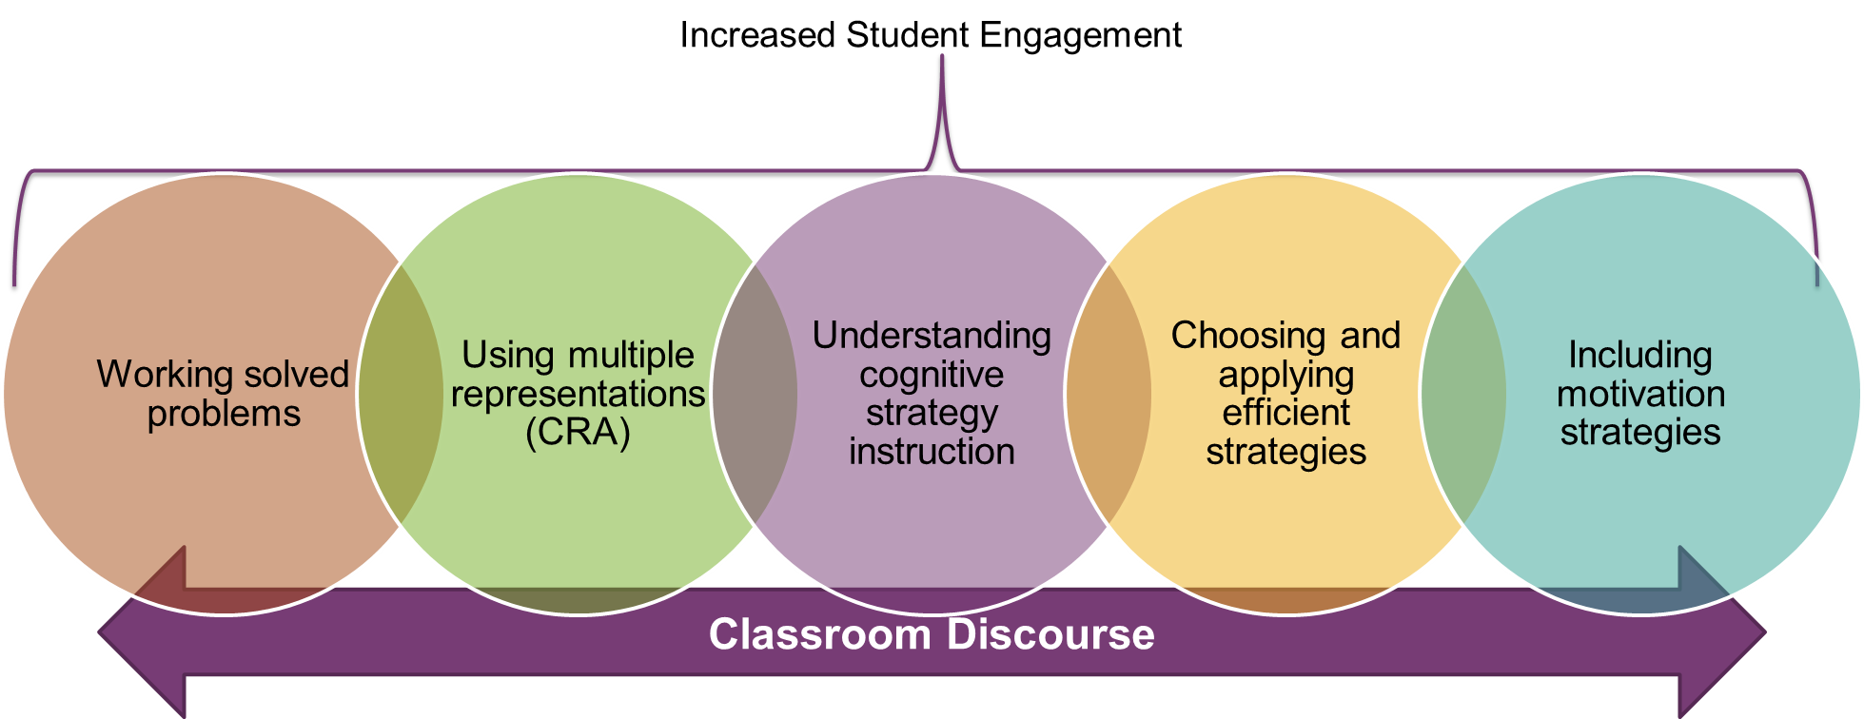
Mathematics Evidence-Based Practices (continued)
Notes:
[Following discussion] For discourse to be evident in the classroom, we need to create a learning environment in which students feel and see success. For students with mathematics difficulties, this means that teachers need to be intentional and purposeful in using evidence-based practices, such as working solved problems, using multiple representations often referred to as concrete-representational-abstract, explicitly teaching effective strategies and cognitive strategy instruction, and motivation strategies that can lead to increased self-regulation.
[Click for animation]
When students are successful and developing conceptual understanding, they are more likely to be engaged and have the skills to actively participate in classroom discussions. When this happens, a teacher is truly increasing classroom discourse.

Slide 30
What Is Discourse?
Mathematical discourse is about whole-class and small-group discussions in which students talk about mathematics in such a way that they reveal their understanding of concepts.​
Discourse involves asking strategic questions that elicit from students both how a problem was solved and why a particular method was chosen, discussing whether the particular method chosen was valid and why this method works.​
Students learn to critique their own and others’ ideas and seek out efficient mathematical solutions.
(Herbel-Eisenmann & Otten, 2011; Simpson et al., 2015)
Notes:
[Read slide.]

Slide 31
Facilitating Meaningful Discourse
Discourse includes purposeful discussion but also includes verbal, visual, and written communication.
Teachers need to consider the best way to include discourse that leads students to learn and how to solve.
Students who struggle may need additional support, with the teacher considering the following:
Different ways to support students
Different types of questions or lower level questions prior to higher level questions
Assist students to provide explanations through sentence stems
Allow and encourage different representations, less focus on verbal (for example)
(Hufferd-Ackles et al., 2004; National Council of Teachers of Mathematics [NCTM], 2014)

Slide 32
Question Types

Slide 33
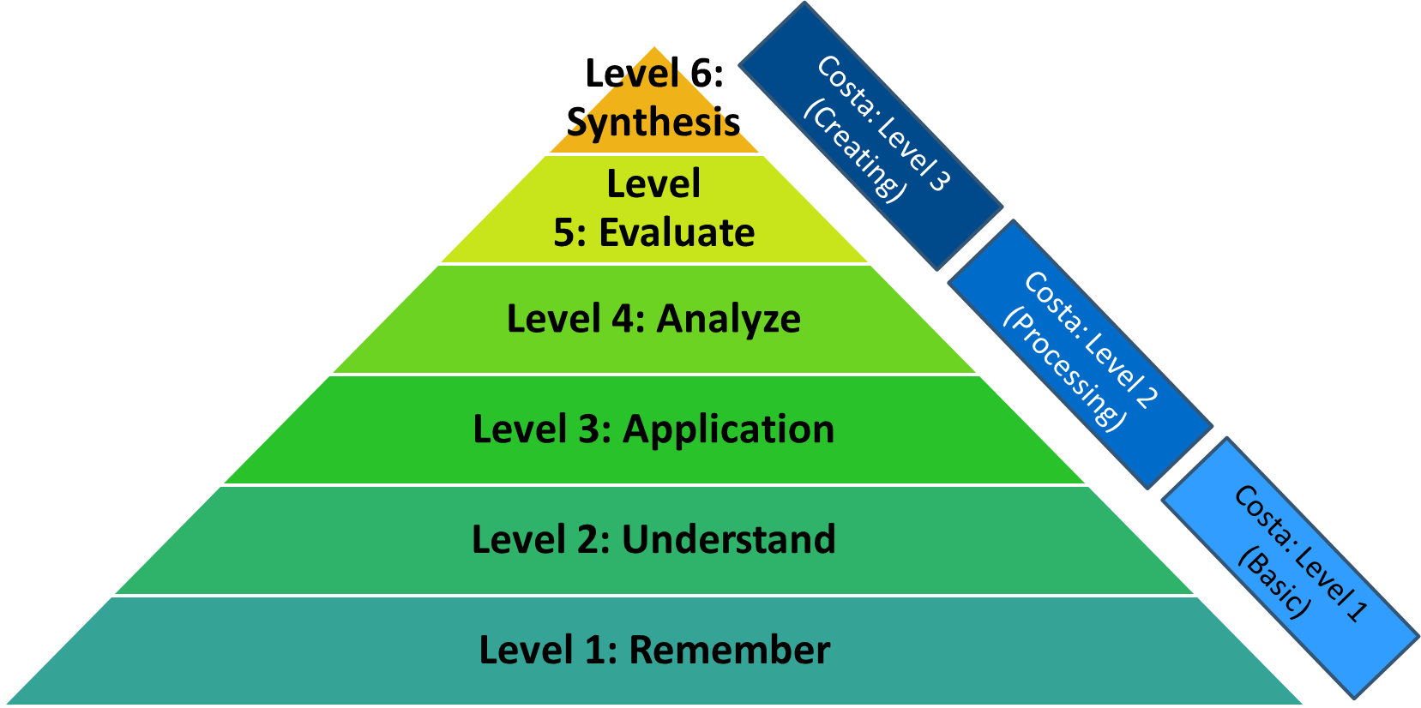
Question Types (continued) 1
Notes:
It is easy to direct teachers to include inquiry-based questions, but what does that mean? Here are two examples of common ways to think about questions. The main triangle is Blooms Taxonomy. In a majority of classrooms, questions tend to be more Level 1: Remembering. This can include asking students for a formula, an answer, the procedures. It is about the student simply recalling or remembering. In classrooms we also see some Level 2: Understand questions. These questions are often evident in the warm-up, with a follow-up in asking students to go deeper in understanding or how they solved. Level 3 can be a bit more challenging to include in the classroom “lecture” portion but is often evident in practice or homework. Levels 4, 5, and 6 tend to be more challenging to incorporate in middle school classrooms. These higher level questions tend to be part of a project or require examining or analyzing worked samples.
Another common framework for organizing questions is Costa’s Level of Questioning, sometimes referred to as Costa’s Level of Inquiry. Costa has only three levels, but they are similar to Bloom’s Taxonomy, with Level 1 more of Level 1 and 2 from Bloom’s Taxonomy.
For more information, see https://www.math.toronto.edu/writing/BloomsTaxonomy.pdf, http://www.ccconline.org/wp-content/uploads/2013/11/Bloomstaxonomyformath.pdf, https://www.asd5.org/cms/lib4/WA01001311/Centricity/Domain/145/Costas.pdf, https://oepos.ca.uky.edu/files/costas_-_question_stems_by_content_area.pdf

Slide 34
Question Types (continued) 2
Level | Key terms | Sample question
Remember | List, define, describe, show, name, what, when . . . | What is mean? What is the formula to find the area of a square?
Understanding | Summarize, compare and contrast, estimate, discuss . . . | Find the slope of the tangent line to the following function. How are perimeter and circumference similar? Different?
Applying | Apply, calculate, complete, show, solve, modify . . . | Calculate the area of the circle.
Analyzing | Separate, arrange, classify, explain . . . | In 16x = 32, what would happen to the product if x was increased by 3.
Evaluating | Integrate, modify, substitute, design, create, what if, formulate, generalize, prepare . . . | Optimize the given quantity after generating the function that represents the given quantity.
Creating | Assess, rank, test, explain, discriminate, support . . . | Related word problems or real-life word problem that apply multiple skills.
Notes:
[Sample question prompts. If time allows, have participants brainstorm questions on large chart paper to be used later in session. Additional sample questions can be found at http://www.ccconline.org/wp-content/uploads/2013/11/Bloomstaxonomyformath.pdf]

Slide 35
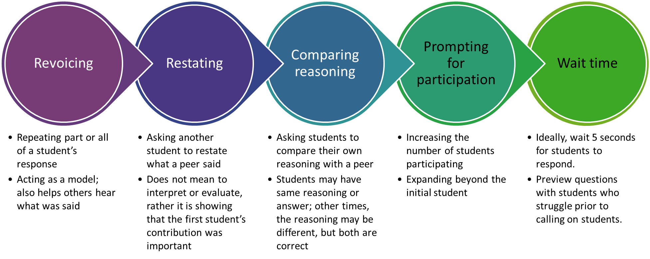
Instructional Strategies for Questioning
(Turner et al., 2013)
Notes:
[Read slide.]

Slide 36
Scaffolding Instruction
Teacher and peer scaffolds
Increased support when new concepts are introduced; support is gradually faded
Teaches students how to ask and answer questions
Content scaffolds
Easier concepts or skills are introduced first; consider the use of math trajectories to target prerequisite skills
Previews new skills, including cognitive strategies
Task scaffolding
Building from easier to more difficult tasks or adding concrete materials or visuals to decrease the difficulty level
Reduces the step size, or the jump, from one idea to the next
Material scaffolding
Offering a variety of materials to support student thinking
Notes:
Many times, we think about scaffolds only within Universal Design for Learning rather than as a part regular part of instruction and a means to increase student discourse. Understanding scaffolds is key to meeting the needs of students who struggle, as well as the needs of ALL students. These are examples that the general educator or special educator can think about when working with students with math difficulty. [Read slide.]

Slide 37
Let’s Practice: Sample Transcripts From a Middle School Classroom
Teacher: In order for me to get to the unit rate, I’m still going to calculate the what?
Student: Slope.
Teacher: The slope. OK? How many points do I need to calculate slope?
Student: Two.
Teacher: Two. So, I’m going to use these two points. I’m going to use the middle two. Be a little different.
Teacher: OK, 415 - 265?
Student: 150.
Teacher: And then 7 - 4.
Student: 3.
Teacher: OK, so I’m here. I want the unit rate. What do I do now?
Student: Divide it by three.
Teacher: Divide it out. So, 150/3 would give me what?
Student: 50.
Teacher: OK. So, the correct answer here would be what?
Student: B.
Teacher: B. $50 per week.
Notes:
[Review slide. Have one participant read as the teacher and the other participant read as the student.]
How many questions did the teacher ask? How would you categorize the questions?
[Participants can categorize by Bloom and/or Costa; these questions are all Level 1 questions. The last question could possibly be Level 2. Click for animations.]
Were the questions successful in leading to more discussion? What additional questions could the teacher ask, or how might you change these questions to increase student discussion?

Slide 38
Practice (cont.)
Teacher: Student X, look at your answers and look at everybody’s answers at your table.
[silence]
Teacher: What are the same or differences in your answers to those?
[silence]
Teacher: Do you have the same answers, or do you have different ones?
Student: They are the same.
Teacher: The same. What about student Y?
[silence]
Student: They are the same.
Teacher: The same?
[silence]
Teacher: So, 15 goes into—one goes into 15 how many times?
Student: Two.
Teacher: 15. Can we use two?
Student: No.
Teacher: No. Then we went to five. Five times three is 15. Can we use six?
Student: No.
Teacher: No. Then we go on to three. Can we use four?
Student: No.
Notes:
[Review slide. Have one participant read as the teacher and the other participant read as the student.]
How many questions did the teacher ask? How would you categorize the questions?
[Click for animations.]
Were the questions successful in leading to more discussion? What additional questions could the teacher ask, or how might you change these questions to increase student discussion?

Slide 39
Let’s Chat: Opportunities
What is your role as a teacher in the classroom?
How do you provide opportunities for students to discuss?
How do you provide opportunities for students to ask questions?
Notes:
[In small groups, have participants discuss and then share.]

Slide 40
Opportunities
Review this small section of a lesson from a Grade 6 classroom:
Teacher: It is D as in dog because ST is the longest, not SR. But let us just take a second because I kind of skipped over C. Let us look at this.
Teacher: Remember how I had you name your triangle by your angles and sides? So, this is saying the triangle is a right triangle.
Teacher: Why is it right?
Teacher: What makes it right?
Teacher: Because literally that one right angle, right? Perfect.
Notes:
[Read slide.]
This is an actual conversation in a middle school classroom from a math project. What do you notice? Any wonderings? Yes, this is an actual conversation, and the students were not cut from the transcript; the teacher did not allow time for discussion. Considering this conversation, what is the role of the teacher?

Slide 41
Practice!
In small groups, complete the following steps:
First
Read over the transcript from a middle school classroom.
Highlight the questions.
Identify the question levels.
Then
Insert questions or rewrite questions that are higher level.
Last
Share with your group.
Notes:
[Have participants work in small groups using the sample transcripts. Have participants share and discuss when complete.]

Slide 42
Review Your Transcript
Read through your transcript.
Highlight the questions.
Identify the discourse and code the questions and discussion opportunities.
Identify types of questions (Bloom’s Taxonomy; refer to table).
Highlight discussion opportunities.
Identify the number of open-ended questions versus closed or answer-only questions.
Write the questions on the T-chart on the chart paper.
Work with your grade level to change the questions that could lead to more student discussion.
Notes:
[Have teachers complete and then discuss insights. What did they think? Why is it so hard to ask questions that lead to discussion? For special educators who are in co-teaching positions, have them identify ways to support students.]

Slide 43
Scaffolding Discourse
Think about your transcript. If there was student discussion . . .
What happened to help promote the discussion?
What scaffolds (e.g., picture, materials) were available?
How did the scaffolds support student(s)?
Think about your transcript. If there was not student discussion . . .
What could have helped to facilitate discussion?
What scaffolds could have been used to increase student understanding and discussion?
Notes:
[Read slide.]
Also consider, what is the role of a special educator. How could an additional adult in the room support discourse and student learning?

Slide 44
Instructional Planning and Identification of Tasks

Slide 45
Identifying Tasks for Questions
Asking higher quality questions can lead to increased student discussion and discourse, but discourse often starts with the task.
Students need a mix of low-level, practice tasks and tasks that lead to generalizations and the use of high-level tasks.
In selecting tasks, consider the following:
Are there multiple starting or entry points? What scaffolds may students who are struggling need in order to access the task?
Are there different ways to solve?
Can you pair a lower level question with a higher level question or follow-up tasks?
Notes:
[Read slide.]
Although it is important to think about questions, you also need to consider the types of tasks that you are presenting in class. Too often, tasks are great for practicing a certain problem type but may not be beneficial to classroom discussion and discourse. Consider tasks that may yield different ways to solve, highlight misconceptions, and allow different entry points.

Slide 46
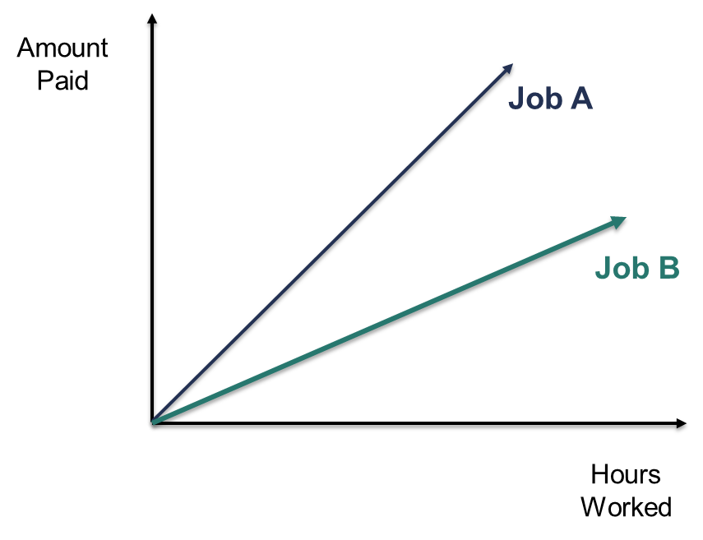
Task 1
Job A and Job B involve the same duties and responsibilities. Which job would you prefer and why?
Notes:
Look at this problem or task. What do you notice? What level of question? We often think that simply attaching a higher level question to a task will increase engagement. But consider this task. There is only one answer, and the cognitive load is low.

Slide 47
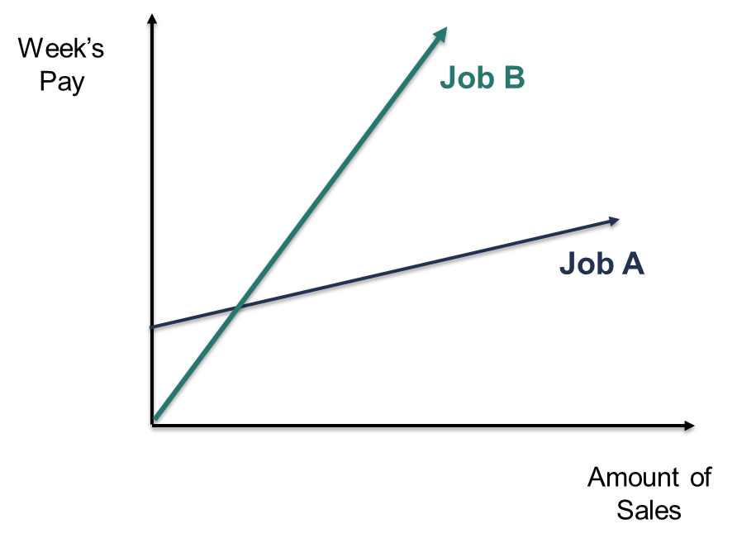
Task 1: Updated
Job A and Job B are sales jobs. Which job would you prefer and why?
Notes:
What makes this task different than the first task? Consider the discussion prior to the answer. What types of questions could you ask? What is the cognitive load in this question compared to the previous question?

Slide 48
Developing Questions
Good questions
lead to increased participation,
force students to articulate their learning, and
scaffold learning.
Good questions do not take over the thinking of students or provide “too much” information.
(Smith & Stein, 2018)
Notes:
[Read slide.]
We need good questions, but if we do not have tasks that lead to good questions, discourse or discussion is halted before it truly starts. It helps to start with task identification and then pair with good questions.

Slide 49
Dissecting Mathematical Explanations
Two parts:
How was an answer or result arrived at? What was the process used?
Why was that process selected? What were the reasons for choosing to solve in that way, and is the process valid?
(Gresalfi & Cobb, 2006)
Conceptual explanations
Why do you agree with that?
Why do you disagree?
Is this true for all numbers?
How can we know for sure?
Calculation explanations
Present a problem and ask the following questions:
How are we going to figure this out? What should we do? I do not understand. How will that work?
Who has a different way to solve the problem?
How could you add to this idea?
Can you explain what [Student] said in your own words?
Notes:
As teachers, we sometimes get stuck in a rut, meaning we start to increase student discourse but often with the same question type, for example, we use only calculation explanations, rather than a mix of conceptual and calculation. Consider the types of explanations and the transcripts you just completed. Which type could have led to more discussion? What about your own classroom? Do you tend to seek more conceptual explanations or calculations?

Slide 50
Example: Mathematical Task and Questions
http://s3.amazonaws.com/illustrativemathematics/attachments/000/008/748/original/public_task_461.pdf?1462392408
Notes:
Consider this sample task within the Grade 6 coherence map from Illustrative Math. This type of task is not a typical computational explanation because the students are not solving. This math task includes worked samples and asks the students to consider how Sam, Joanna, Kiyo, and Erica thought about solving. What additional or follow-up questions could be asked of the students?
What about students who struggle? What scaffolds might they need to assist in understanding?

Slide 51
Questions “Game”
Create small groups (three to four participants)
Assign roles:
Teacher
Student (stays on task)
Student (strayer)
Student (strayer)
Teacher reads the task, and students solve.
Can solve as themselves or solve as a student might solve
Teacher begins to ask questions.
Students answer the problem.
Stayers answer the questions as student who struggles might answer, meaning they do not always understand or try to “close off” the questions.
Teacher continues to ask questions, apply scaffolds, and asks questions that lead to better understanding and bring the stayers back into the conversation.
Notes:
[Read slide. Put participants into groups and assign Questions 1–5 on the next slides per group.]
One person reads the question, and your “students” answer. As the teacher starts asking questions, one or two “students” begin to stray. A strayer is a student who struggles to stay on task or is not making the necessary connections. As a strayer, think about some of your students who struggle. How would they answer? As the teacher, think about how to scaffold the directions or change the questions so that your strayers can contribute and continue to understand the task.

Slide 52
Question 1
Notes:
Sample problem from NAEP, Grade 8, medium difficulty, 55% were incorrect
*All NAEP questions are available free of charge at the NAEP Questions tool website. See Resources slide for link

Slide 53
Question 2
Notes:
Sample problem from NAEP, Grade 8, 2017, only 36% of students solved correctly, medium difficulty

Slide 54
Question 3
Notes:
Sample problem from NAEP, Algebra, High, Type: SCR, Difficulty Level: Hard; 15% solved correctly

Slide 55
Question 4
Notes:
Sample problem from NAEP, Number properties and operations, Moderate, Difficulty Level: Hard, 35% solved correct

Slide 56
Question 5
Notes:
Sample problem from NAEP, Number properties and operations, Moderate, Type: SCR, Difficulty Level: Hard; 26% correct

Slide 57
Questions and Assessments
Consider the role of high-level questions in class as an ongoing assessment or process to gather data to support teaching and learning of mathematics.
NCTM defines the role of assessment for the following:
Monitoring student progress
Making instructional decisions to modify, scaffold, and differentiate learning
Evaluating student achievement to summarize student understanding
Evaluating programs to make instructional decisions
(NCTM, 2014)
Notes:
[Read slide.]
We often think of assessments as tests, quizzes, and state assessments, but assessments can and should be so much more. When we explicitly and systematically insert higher level questions into our teaching, those questions act as daily data that should be used to guide instruction. How often do you think about the type of questions or plan the questions you will ask beyond simply looking for the answer?

Slide 58
Practice Task 1 and Discourse
Steak costs $6.10 per pound. What would the cost be for a steak that weighs 2 $\frac{3}{5}$ pounds?
BEFORE you solve, what is an estimate of the answer?
Solve.
How did you solve?
Notes:
[Read slide. Give participants time to complete. Have participants shared how they solved.]

Slide 59
Student Answers: Steak Problem
Check out each worked solution. Which solution do you agree with and why?
What follow-up questions would you add?
Student 1:
6 x 2 = 12 + .2 = 12.20
2 x $\frac{3}{5}= \frac{6}{10}$
12.20 + .6 = $12.80
Student 2:
6.10 x 2.60 = $15.86
3/5 = .60 so 2 $\frac{3}{5}$ = 2.60
Student 3:
6$\frac{1}{10}= \frac{61}{10}$ x $\frac{13}{5}$ = $\frac{793}{50}=15 \frac{43}{50}$
Notes:
[Read slide.]
How did each student solve? Was one student more right or more wrong than another student? Why? What, if any, misconceptions are exposed in the answers? How could you use this information in your own class?

Slide 60
Practice Task 2 and Discourse
Melissa saves money for six weeks to buy a sweater. She records her weekly savings. She saves $2.50 for the first week. Each week, she saves $1.25 more than she saved the previous week. Complete the table to show how much Melissa saves each week.
Before you solve, think about HOW you would solve. How would your students solve?
Week | Money saved ($)
1 | $2.50
2
3
4
5
6
(NAEP, 2017 – 8M9 #7 M35553E1)
Notes:
[Read slide. Click for animation. Allow time for participants to solve.]

Slide 61
Student Answers: Money Saved
Check out these solutions. Which solution do you agree with and why?
What follow-up questions would you ask of students?
Student 1:
Student 2:
Student 3:
Week | Money saved ($)
1 | $2.50
2 | $3.75
3 | $5.00
4 | $6.25
5 | $7.50
6 | $8.75
Week | Money saved ($)
1 | $2.50
2 | $3.75
3 | $4.00
4 | $5.25
5 | $6.50
6 | $7.75
Week | Money saved ($)
1 | $2.50
2 | $3.75
3 | $5.00
4 | $6.25
5 | $7.70
6 | $8.75
Notes:
[Read slide.]
How did each student solve? Was one student more right or more wrong than another student? Why? What, if any, misconceptions are exposed in the answers? How could you use this information in your own class?

Slide 62
Supporting Students Who Struggle

Slide 63
Supporting Students Who Struggle
Students who struggle will often need scaffolds and may need lower level questions, working up to higher level questions.
Types of scaffolds:
Multiple means of engagement (the why of learning)
Multiple means of representations (the what of learning)
Multiple means of action and expression (the how of learning)
Notes:
[Read slide.]

Slide 64
Math-Specific Evidence-Based Practices
Systematic Instruction
Precise Math Language
Multiple Representations
Number Lines
Word Problems
Timed Activities
(Fuchs et al., 2021)
Notes:
Evidence-based practices are proven instructional strategies that have led to increased student understanding and outcomes. We reviewed a few of these practices at the beginning of our session and are bringing them back in now to think about how we can utilize these specific evidence-based practices to support students who struggle.

Slide 65
Connection Between Scaffolds and Evidence-Based Practices
Planning for scaffolds and embedding evidence-based practices need to be included in the lesson plan, rather than reactive during the lesson.
Teachers need to review data to determine what scaffolds are needed for students to be successful and pair the scaffolds with instructional strategies to increase conceptual understanding.
Besides pairing scaffolds and evidence-based practices, it is imperative that general and special educators collaborate so that specially designed instruction is part of each lesson, alongside scaffolds.
Notes:
[Read slide.]

Slide 66
Closing

Slide 67
In Closing
Computation tasks should be structured to promote inquiry (and thus student conversation) about the best approach, the validity of the process, or the discovery of a rule or property.
Students will need a lot of modeling and support in how to discuss.
Consider modeling with a co-teacher and providing sentence starters and activities that lead to discussion.
Break the class into two groups for students to practice discussing and asking and answering questions.

Slide 68
Fostering Conversation
In planning lessons, consider multiple ways, such as the following, to interject opportunities for student discussion and discourse, while checking for understanding:
Investigate reasonableness.
Define a concept and then compare definitions, merits, and validity.
Justify or explain different approaches or perspectives.
Interpret representations.
Foster student discourse by focusing on the what and why of the math, rather than on the how.

Slide 69
Resources and References

Slide 70
Resources
COHERENCE MAP
NAEP QUESTIONS TOOL
SBAC SAMPLE QUESTION LINK
Notes:
Many questions that were included are available for free within the coherence map, NAEP questions tool, and SBAC sample question bank.

Slide 71
References
Baddeley, A. D., & Logie, R. H. (1999). Working memory: The multiple component model. In A. Miyake & P. Shah (Eds.). Models of working memory (pp. 28–61). Cambridge University Press.
Fuchs, L. S., Newman-Gonchar, R., Schumacher, R., Dougherty, B., Bucka, N., Karp, K. S., Woodward, J., Clarke, B., Jordan, N. C., Gersten, R., Jayanthi, M., Keating, B., & Morgan, S. (2021). Assisting students struggling with mathematics: Intervention in the elementary grades (WWC 2021006). National Center for Education Evaluation and Regional Assistance, Institute of Education Sciences, U.S. Department of Education. http://whatworks.ed.gov/
Geary, D. (2004). Mathematics and learning disabilities. Journal of Learning Disabilities, 37(1), 4-15.
Gresalfi, M.S., & Cobb, P. (2006). Cultivating students’ discipline-specific dispositions as a critical goal for pedagogy and equity. Pedagogies: An International Journal, 1(1), 49-57.
Herbel-Eisenmann, B. & Otten, S. (2011). Mapping mathematics in classroom discourse. Journal for Research in Mathematics Education, 52(5), 451-485.
Hufferd-Ackles, K., Fuson, K. C., & Sherin, M. G. (2004). Describing levels and components of a math-talk learning community. Journal for Research in Mathematics Education, 35(2), 81–116.

Slide 72
References (continued)
National Council of Teachers of Mathematics. (2014). Principles to actions. Ensuring mathematical success for all. National Council of Teachers of Mathematics.
National Council of Teachers of Mathematics. (2014). Principals to action. Ensuring mathematical success for all. National Council of Teachers of Mathematics.
SanGiovanni, J., & Novak, J. R. (2018). Mine the gap for mathematical understanding. Grades 6–8. Corwin.
Siegler, 1988
Simpson, A., Mokalled, S., Ellenburg, LA., & Che, M. (2015). A tool for rethinking teachers’ questioning. Mathematics Teaching in the Middle School, 20(5), 294-302.
Smith, M., & Stein, M. K. (2018). 5 practices for orchestrating productive mathematics discussions: Second edition. Corwin.
Turner, E., Dominguez, H., Maldonado, L., & Empson, S. (2013). English learners’ participation in mathematical discussion: Shifting positionings and dynamic identities. Journal for Research in Mathematics Education, 44(1), 199–234. https://doi.org/10.5951/jresematheduc.44.1.0199
Wehmeyer, M. L. (1992). Self-determination and the education of students with mental retardation. Education and Training in Mental Retardation, 27, 302–314.

Slide 73
Disclaimer
This content was produced under U.S. Department of Education, Office of Special Education Programs, Award No. H326M17002. Christina Diamond serves as the project officer. The views expressed herein do not necessarily represent the positions or polices of the U.S. Department of Education. No official endorsement by the U.S. Department of Education of any product, commodity, service, or enterprise mentioned in this website is intended or should be inferred.

